Slide 1
GYM MANAGEMENT SYSTEM

Slide 2
Project analysis by Simran Tanti
> Cafe management
> Hospital management
> Photo editing
> Payment app

Slide 3
Project analysis by Dharvi Kotak
> Food ordering
> Chat app
> Notes app
> Password creation

Slide 4
Project analysis by Pruthvi Thummar
> School management
> Video creation
> Boutique center
> Sports center

Slide 5
Project analysis by Dharam Bhut
> House rent
> E-commerce
> Activity center
> Travels management

Slide 6
AIM OF THE PROJECT
To make fit our self
Weight loss
Muscles building
One of the main aim is healthy living

Slide 7
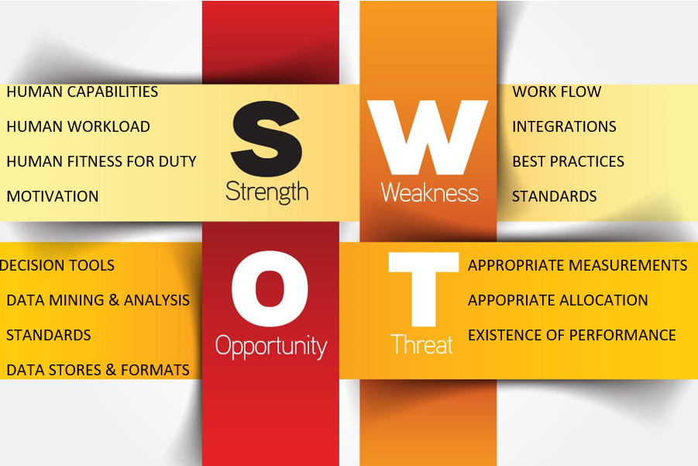
SWOT Analysis
STRENGTHS
Good
S

Slide 8
PROPOSED SYSTEM
The proposed system is used for stores records of the system.
It is easier to find the user names, workout timings, summery etc.
Time table is orderly arranged. It has implemented an information of about the gym, about fees structure and schedule of workout days and also schedule of daily diet for every members.
Then, the gym was provided a supplement store for viewing what all specialties’ are of workout and diet. Gym admin can maintain the daily attendance and workout summery.
This application will also notify the user (gym members) about their fees and also notifies the gym owner about the payment clearance.

Slide 9
ADVANTAGES OF PROPOSED SYSTEM
The proposed system is highly secured, because for login the system it requires the username and password which is different for each department therefore providing each department a different view of the customer information.
It provides wide range of certain criteria in each window the client is working for better and quicker solution.
It maintains report for all criteria and transactions.
Manages member information separately for all bill information separately for considering the requirement of gym.
Stores information about regular products.
Diet recommendation

Slide 10
MODULE LIST
ADMINISTRATOR
Login
Add Member
Update/Delete Members
Create Bills
Assign Fee Package
Assign Notification for monthly
Report export
Supplement store
Diet Details

Slide 11
MODULE LIST
USER
Login
View Bill Receipts
View bill notification
View diet
View attendance
View schedule

Slide 12
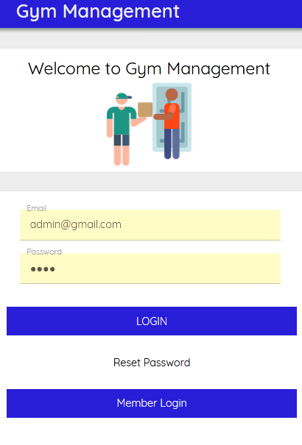
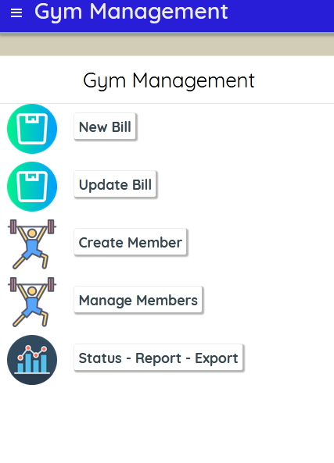
SCREENSHOTS

Slide 13
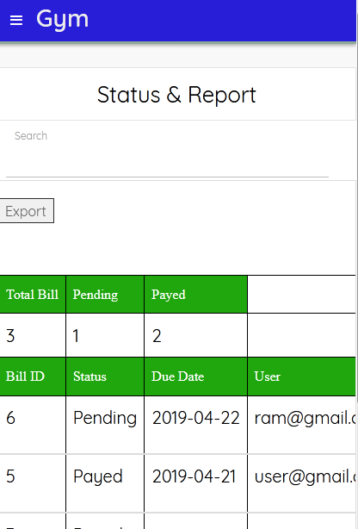
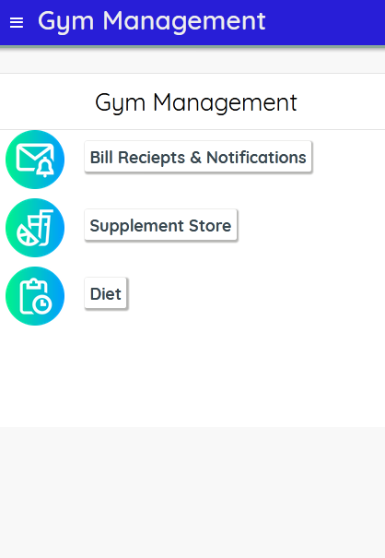

Slide 14
CONCLUSIONS
The “GYM MANAGEMENT SYSTEM” is successfully designed and developed to fulfilling the necessary requirements, as identified in the requirements analysis phase, such as the system is very much user friendly, form level validation and field level validation are performing very efficiently.
The new computerized system was found to be much faster and reliable and user friendly then the existing system, the system has been designed and developed step by step and tested successfully.
It eliminates the human error that are likely to creep in the kind of working in which a bulk quantity of data and calculations as to be processed.
The system results in quick retrieval of information that is very vital for the progress any organization. Cost is minimized in case of stationary.
Burden of manual work is reduced as whenever transaction takes place, there is a no need to record it in many places manually.

